Slide 1

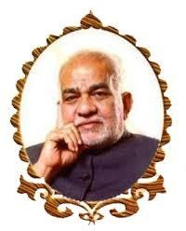
BVRIT HYDERABAD
college of engineering for women
Department of
INFORMATION TECHNOLOGY
FASHION RECOGNITION
Under guidance of Mr.Ganapathi
Team No:4
Sneha Reddy Muddasani-21WH1A1217
PL.Varshita-21WH1A1218
M. Sree Akshitha-21WH1A1219
S.Akshaya-21WH1A1220
Vaishnavi Reddy Sheri-21WH1A1222

Slide 2
PROBLEM STATEMENT
Develop a deep learning model for fashion image classification. The model will take fashion item images as input and categorize them into various apparels and footwear categories, such as shirts, pants, dresses, and shoes, based on the provided dataset.
The goal is to achieve high accuracy in classifying fashion items. The trained model and label encoder will be provided as deliverables for fashion-related applications.

Slide 3
MODULES AND PACKAGES
numpy - Python library for numerical and array operations.
pandas - Python library employed for data manipulation and analysis.
os - Python module to interact with operating system.
tensorflow - Used as deep learning framework to build train and deploy machine learning models, particularly for image classification tasks.
keras - Serves as an integral part of TensorFlow, providing a high-level neural networks API for streamlined model building and training in image classification tasks.

Slide 4
Streamlit - A Python library or framework utilized to build a user-friendly web application for displaying information, text, and interactive elements, allowing users to interact with the machine learning model and its predicti
matplotlib - Matplotlib is a popular Python library for creating static, animated, or interactive visualizations and plots for data analysis and presentation.
sklearn - A machine learning library for Python that provides simple and efficient tools for data analysis and modeling, including classification, regression, clustering, and more.

Slide 5
MODEL SELECTED
CNN :
CNNs are a type of deep learning model designed for image-related tasks. They automatically learn and recognize patterns in images using convolutional layers, pooling layers, and fully connected layers. They've had a huge impact on image classification, object detection, and more. CNNs use filters to extract features, reducing the need for manual feature engineering.

Slide 6
CONTRIBUTION OF TEAM
Roll Number | Name | Contribution
21wh1a1217 | Sneha Reddy.M | GUI, Research, Presentations
21wh1a1218 | P.L.Varshita | GUI, GUI interface, Data preprocessing
21wh1a1219 | M.Sree Akshitha | Data augmentation, normalization,Model training and testing
21wh1a1220 | S.Akshaya | GUI, Research
21wh1a1222 | Sheri Vaishnavi | Model training, Integrating with GUI, Deploying

Slide 7
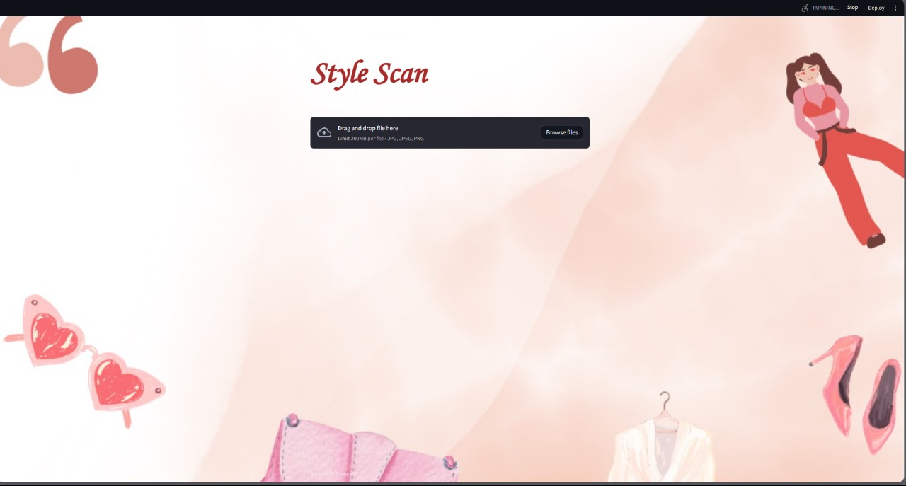
EXECUTION

Slide 8
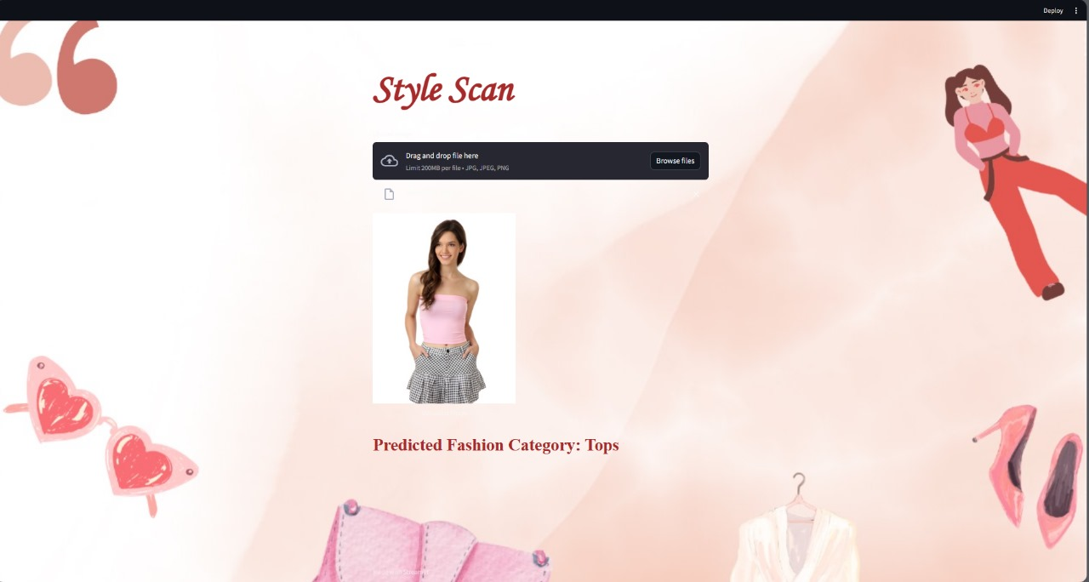

Slide 9
References
https://machinelearningmastery.com/how-to-develop-a-cnn-from-scratch-for-fashion-mnist-clothing-classification/
https://www.kaggle.com/code/paramaggarwal/fashion-product-images-classifier
https://github.com/mj703/Fashion-Recommendation-System
https://github.com/aakashjhawar/dress-pattern-recognition-using-CNN/blob/master/image_similarity.ipynb

Slide 10
THANK YOU

